Slide 1





Final presentation
Cost-effective Monitoring System for Biomedical and Cleanroom Facilities
EE499 – Winter 2022
Team 8

Slide 2
General project information
Project Title
Cost-effective Monitoring System for Biomedical and Cleanroom Facilities
Project Timeline
December 2022 – November 2023
Project Sponsor
King Abdulaziz University, Faculty of Engineering, Department of Electrical and Computer Engineering

Slide 3
Customer & Advisor
Project Stakeholders
Team#08
Dr. Nebras Sobahi
nsobahi@kau.edu.sa
Omar Abdulaziz Hussain (ECE)
Omoosaharoonamirhussain@stu.kau.edu.sa
+966507621903
#1
Ibrahim Mohammed Ahmed (ECE)
iibrahimahmed@stu.kau.edu.sa
+966500954858
#2
Abdullah Abu bakr Alkaf (ECE)
aalkaf0013@stu.kau.edu.sa
+966508393281
#3

Slide 4
agenda
1. Introduction
2. Conceptual Design
4. Implementation Plan
5. Results and Evaluation
7. References
3. Product baseline Design
6. Conclusion

Slide 5
1. Introduction
About the project
Background information

Slide 6
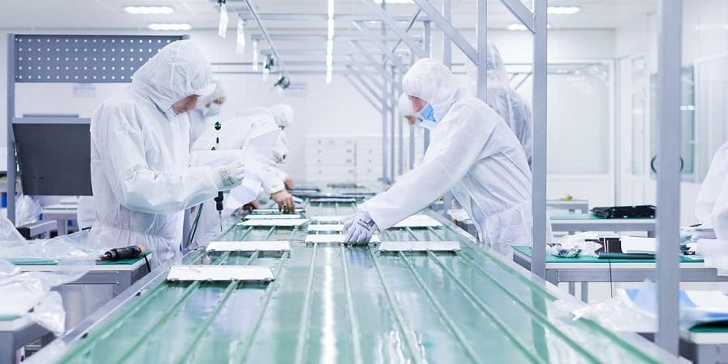
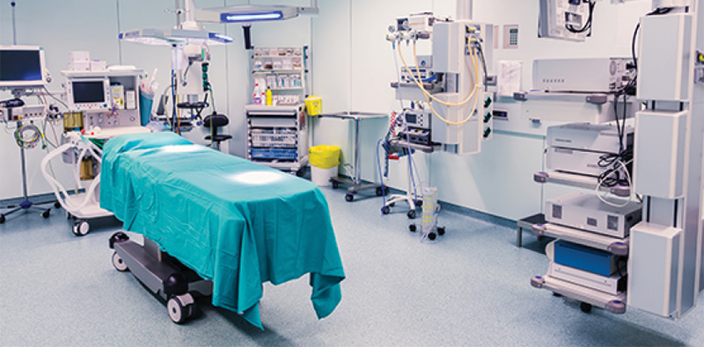
About the project
What is cleanroom?
Include critical processes
Sensitive from particle
Closed regulated environment
Examples of cleanroom
Surgery rooms
Material storage rooms
Laboratory rooms

Slide 7
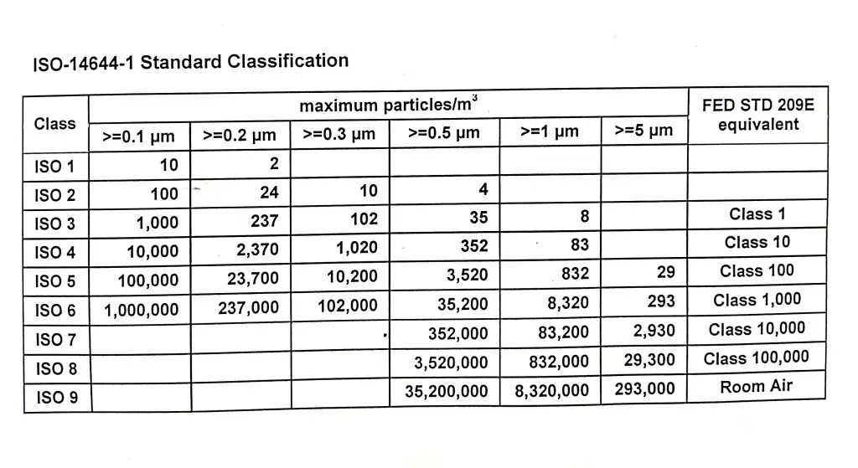
Background information
Cleanroom Classifications
The Federal Standard 209 ( FS 209E )
Ex: Class 100,000 – Class 1,000
ISO 14644-1 standard
Ex: ISO1, ISO2,…ISO9
Source: : Lourdes M. Caselli-Fernández1
, Dr. Robert, Clean room environment, personnel, quality assurance and
their monitoring, https://rb.gy/yeh44g

Slide 8
Background information
Statement-Restatement Method
KT Decision Analysis

Slide 9
2. Conceptual design
Situation Description
Problem Definition
Project Objectives
Realistic Constraints
Product design specifications (PDS)
Literature Review
Analyzing Alternative Solutions
Maturing Baseline Design

Slide 10
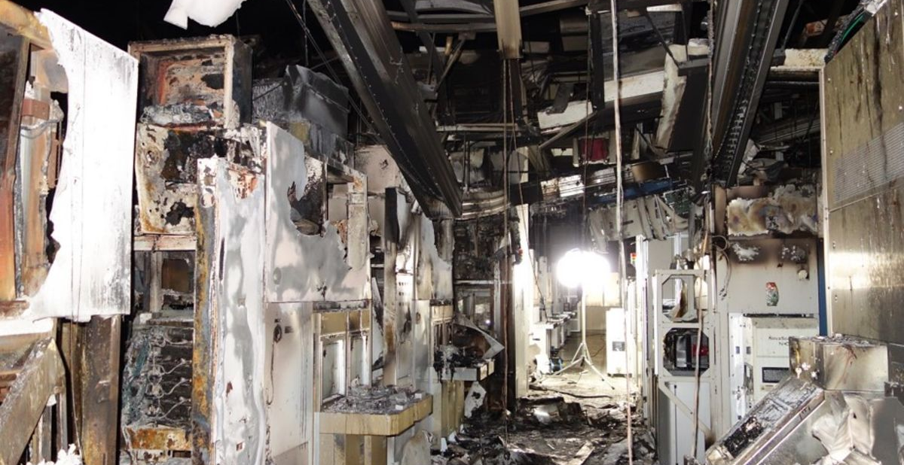

Situation Description
Fires & Disasters.
Gas leakage accidents.
Damaging materials & Equipment.
Expensive available products in the market.
[A]
Sources:
[A] (Disaster Strikes Supply Chain Again &#8211; Another Chip Factory Destroyed by Fire, 2021)
[B] (India Gas Leak: At Least 11 Dead After Visakhapatnam Incident, 2020)
[B]

Slide 11
Problem definition
Initial problem statement
Monitoring systems for biomedical and cleanroom facilities are mostly expensive.
Final problem statement
the available monitoring systems are mostly expensive and not suitable for all kinds of cleanrooms.

Slide 12

Project objectives
High-level Objectives
Cost effective monitoring system
Monitoring system for any regulated environment
Expandable monitoring system
Low-level Objectives
Monitoring the environment inside the cleanroom
Detecting particles in air
Alarming system

Slide 13

Realistic constraints
The total cost of the product must not exceed 3,500 SR.
The operations inside the cleanroom must not be affected by the product’s material.
The product must always be in operation mode.
The product must be able to be completed by the scheduled deadline.

Slide 14
Product design specifications
In-scope objectives (Musts)
Out-scope objectives (Wants)
Realistic assumptions

Slide 15
in-scope objectives (must)
Expandable and capable to accommodate multiple
sub-systems
The system Monitor by it-self without human intervention
The system must have backup battery in case of blackout happen
The system should monitor the temperature, humidity, and particles in air inside the cleanroom.
The design send alarming SMS massages.

Slide 16
out-scope objectives (wants)
the cost of the design doesn’t exceed 2,500 SR
The product can detect motions inside the cleanroom
The design is Affordable for any kind of cleanroom
The design can use Wi-Fi in the alarming system
The product displays the data continuously via internet website

Slide 17

Realistic Assumptions
Provided power supply
Availability of product’s components in local market
Controlled air conditioning

Slide 18
Literature review
Previous Projects
Internet of Things (IoT) Monitoring System of a Modeled Cleanroom^{[1]}
Internet of things (IoT) humidity and temperature monitoring system^{[2]}

Slide 19
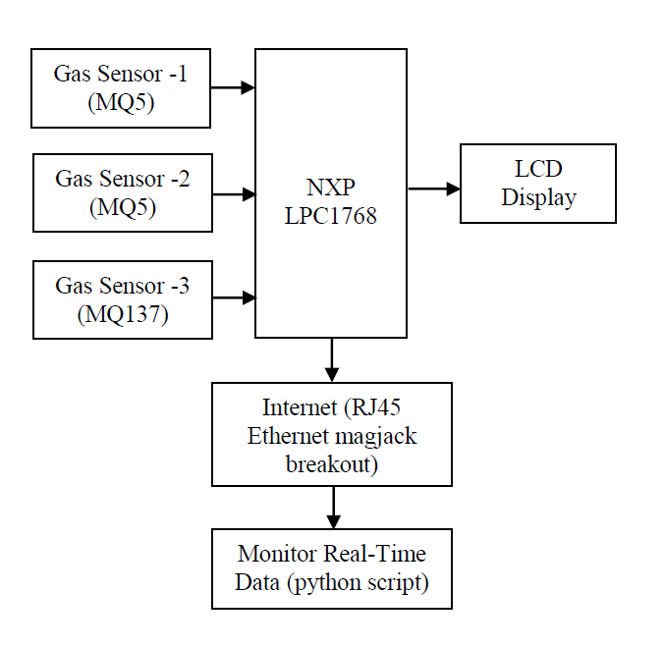
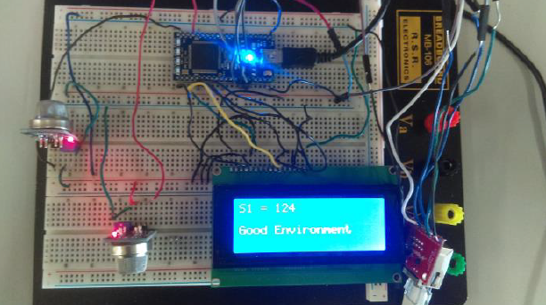
Cont. Previous projects
Gas and Air Quality Detection, and Monitoring Using Embedded System for Nanofabrication Facility^{[3]}

Slide 20

Cont. Literature review
Section-1
Basic components of cleanrooms
Section-2
Designing and construction of cleanrooms
Section-3
Operations and monitoring in cleanrooms
Section-4
Quality management in cleanrooms
Section-5
Clinical outcomes and new developments
Section-6
International experience and some case studies
Cleanroom Technology in ART Clinic: A Practical Guide^{[4]}

Slide 21
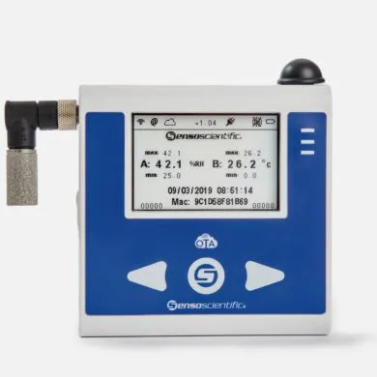
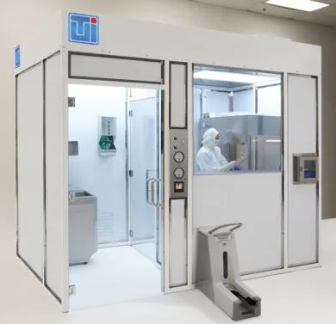
Available products in market
Clean room Monitoring system B13-200-OTA by Co. senso scientific^{[5]}
USP 800 Hard wall Cleanrooms for Hazardous Drug Compounding by CO. Terra universal^{[6]}
Price: 7,989 SR
Temp Measurement Range:
-40°F to 257°F (-40°C to 125°C)
Humidity Range: 0% to 100% RH
Tolerance: ±0.5°C; ±2% RH (0% RH to 90% RH and 0°C to 60°C)
RF Frequency: 2.4 to 2.497 GHz
ISO Class : ISO-7
Price: 98,864 SR
Application: USP 800 (Sterile HD)
Width: 12', 10', 16’
Depth: 12', 10', 6', 8’
Height: 8’
Panel Material: Polypropylene
ISO Class: ISO 5
Features available for logging and storing room pressures and temperature
Pressure sensor included in each room

Slide 22
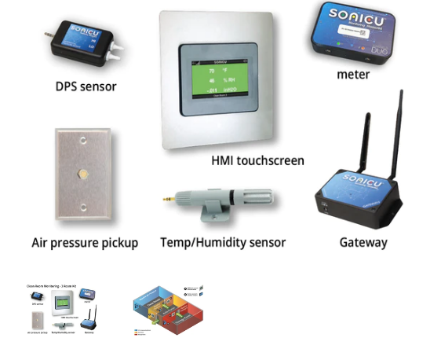
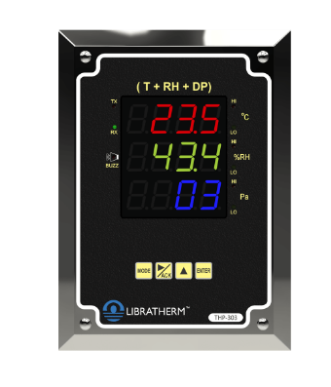
Cont. Available products in market
Cleanroom Monitoring – 3 Room Kit By CO. SONICUE^{[7]}
Clean Room Monitoring System – THP-303^{[8]}
Product specifications:
Price: 1,856 SR
Temperature range: -40.0 to 60.0 °C /-40.0 to 140.0 °F
Temp accuracy: +/- 0.3 °C/ °F
RH% Range: 0.0 to 100.0 %RH
RH Accuracy: +/-1.0 %RH
Diff. Pressure Range: +/-100 mmWC or +/-999 Pascal
DP Accuracy:+/- 1% of the calibrated range.
Product specifications:
Price: 27,651 SR
Differential Pressure Sensor (with NIST calibration certificates)
Temp/Humidity sensor (with NIST calibration certificates) DPS Differential Air Pressure Sensor: Accuracy: +/- 0.25%, Range: +/- 4 in H2O
Temp Range: -10˚C to +80˚C / Humidity Range: 0-80% RH

Slide 23


Alternative designs

Slide 24
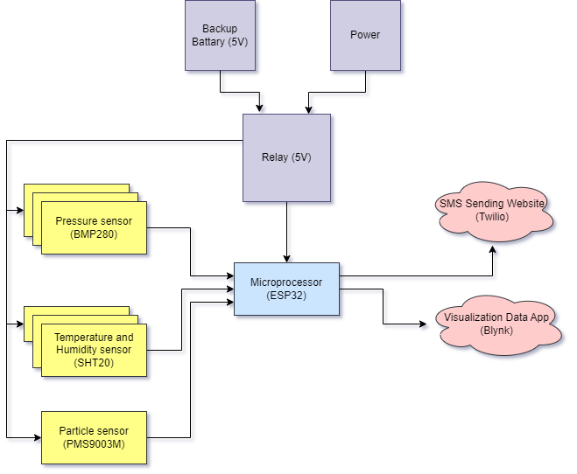
ALTERNATIVE 1
- Components:
Relay (5V)
Battery(5V)
Humidity and Temperature sensors (SHT20)
Pressure sensors (BMP280)
ESP32 Wi-Fi module
Blynk Application
Twilio website

Slide 25
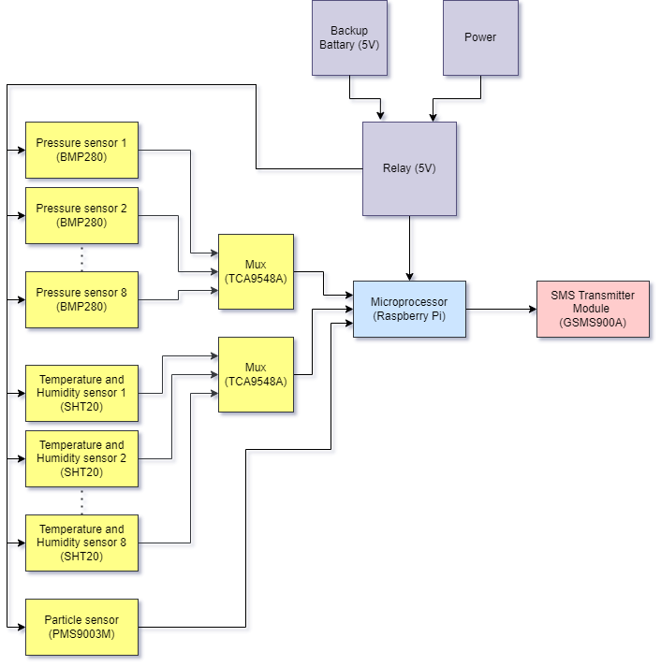
ALTERNATIVE 2
- Components:
Relay (5V)
Battery (5V)
Humidity and Temperature sensors (SHT20)
Pressure sensors (BMP280)
GSMS900A
Raspberry Pi
Multiplexer (CD74HC4051-EP)

Slide 26
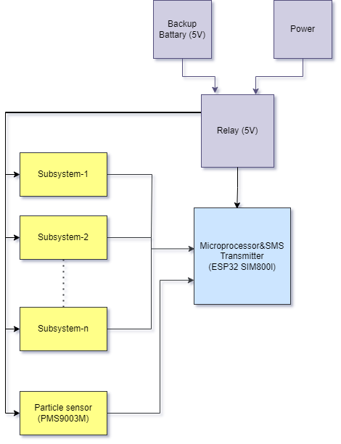
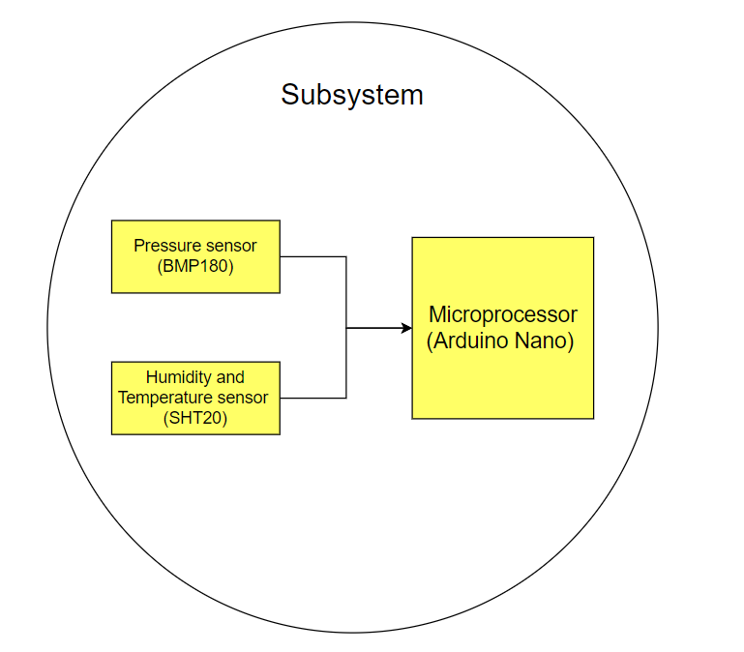
ALTERNATIVE 3
- Components:
Relay (5V)
Battery (5V)
Humidity and Temperature sensors (SHT20)
Pressure sensors (BMP180)
Arduino Nano
ESP32 SIM800l

Slide 27
Pros & cons
Alternative | Advantages | Disadvantages
1 | Display Screen For System’s status Low Cost Small Size | Internet dependent system Covers Short Area
2 | Covers Long Area Flexibility of Input’s Number Range | MUX Delay
3 | High Precision Failure Detection | High Cost More Components

Slide 28

BASELINE DESIGN SELECTION

Slide 29
Kt decision analysis
KT Decision Analysis
Artifacts: |  | Alternative 1 | Alternative 2 | Alternative 3
Must | The system has the capability to monitor the internal environment and connect to multiple sub-systems inside the cleanroom as much as needed. | GO | GO | GO
 | The system must monitor by itself without human intervention. | GO | GO | GO
 | Include backup rechargeable battery for power outages situations that last at least for three hours. | GO | GO | GO
 | The system must measure the humidity, pressure, and temperature. | GO | GO | GO
 | The system can alarm safety and security departments by sending SMS messages. | GO | GO | GO

Slide 30
Kt decision analysis
KT Decision Analysis
Artifacts: |  | Alternative 1 |  | Alternative 2 |  | Alternative 3
Wants | Weight | Rate | Score | Rate | Score | Rate | Score
The cost is lower than 2,500 SR. | 8 | 8 | 64 | 7 | 56 | 2 | 16
The system detects motions in staff area to protect passed out people. | 7 | 4 | 28 | 8 | 56 | 5 | 35
The system can work with several kinds of cleanrooms (Semiconductor cleanroom, biomedical facilities, controlled storage). | 6 | 4 | 24 | 7 | 42 | 6 | 36
The system can use Wi-Fi in the alarming system | 5 | 7 | 35 | 3 | 15 | 6 | 30
Touch screen used to display the parameter adjustment | 4 | 7 | 28 | 4 | 16 | 3 | 12
 |  | Total 1 =179 |  | Total 2=185 |  | Total 2 =129

Slide 31
Maturing baseline design
Approved microprocessor:
Added sensors:
ESP32 SIM800l
Enhance processing performance
Reduces cost
Simplifies the design
RCLW-0516 Motion Sensor
Thing speak cloud
NH3 (MQ-137), Methane(MQ-4), Smoke (MQ -2) Gas Sensors

Slide 32
3. Product baseline design
Matured baseline Block Diagram
Flow Chart
Ranges and Characteristics of Variables

Slide 33
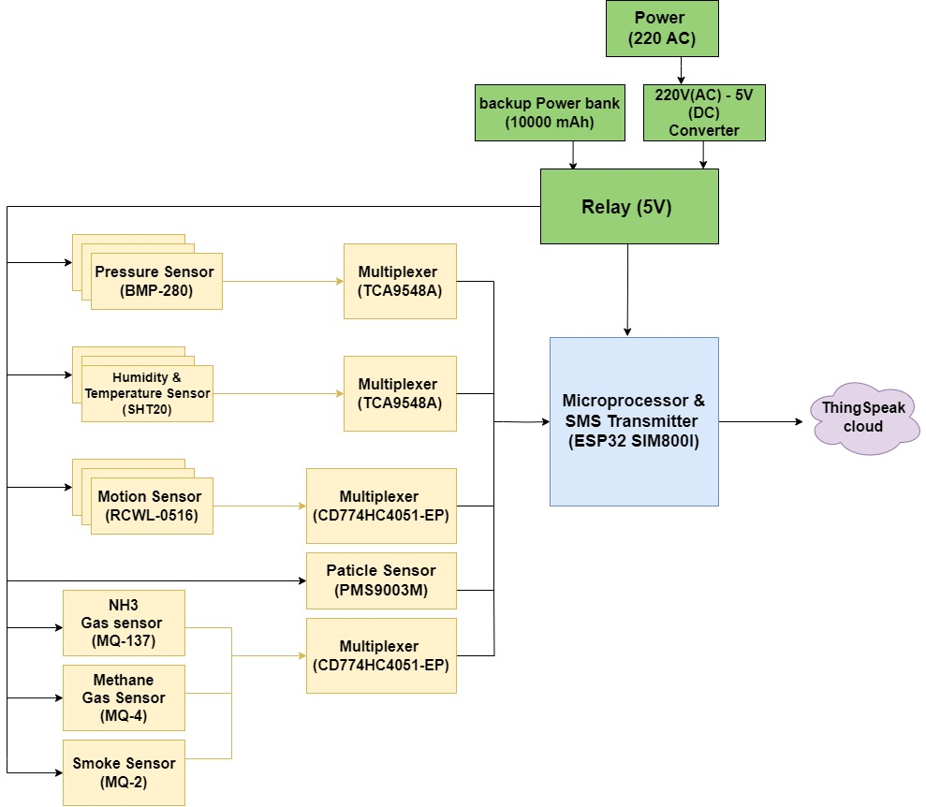
Matured baseline block diagram

Slide 34
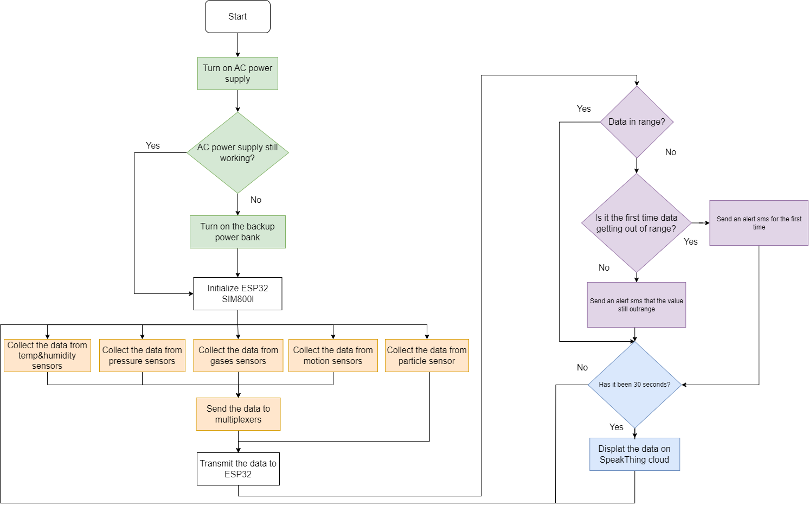
Flow Chart

Slide 35
Ranges and Characteristics of Variables
Temperature degree ^{[9]}
20° - 24°( + 1 degree's variation)
Relative humidity ^{[9]}
30% - 60% ( + 5% degree's variation)
Atmospheric Pressure ^{[10]}
1013 hPa ( + 10 hPa Variation)
Particles ^{[11]}
Particles size > 0.1 um [ (100,000) particle/m³ ]
Particles size > 0.2 um [ (23,700) particle/m³]
Particles size > 0.3 um [ (10,200) particle/m³ ]
Particles size > 0.5 um [ (3,520) particle/m³ ]
Particles size > 1 um [ (832) particle/m³ ]
Particles size > 5 um [ (29) particle/m³ ]

Slide 36
4. Implementation plan
Validation of Essential Sub-systems
Final Comprehensive System

Slide 37
Validation of essential sub-systems
Gases Monitoring Subsystem
Motion Monitoring Subsystem
Temperature & Humidity Monitoring Subsystems
Particle detecting Subsystem
Pressure Monitoring Subsystem
SMS Alarming System

Slide 38
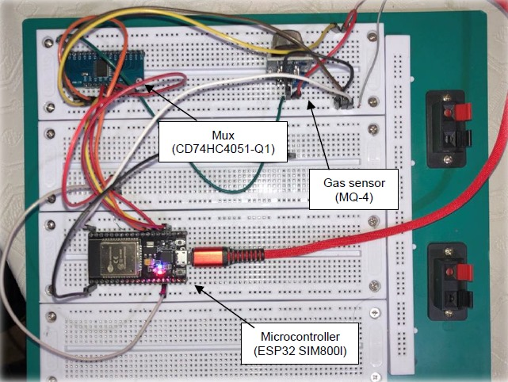
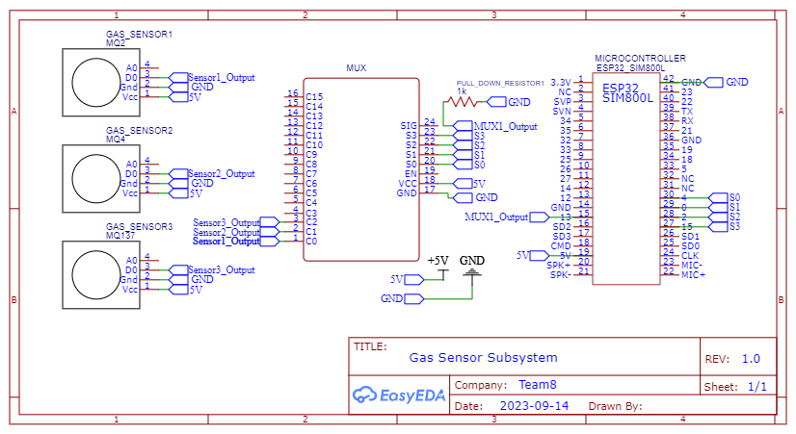
gases monitoring subsystem
Equipment
Breadboard
Connection wires
ESP32 SIM800l microcontroller
1K ohm Resistor
Mux CD774HC4051-EP
Gas sensor MQ-137
Gas sensor MQ-4
Gas sensor MQ-2

Slide 39
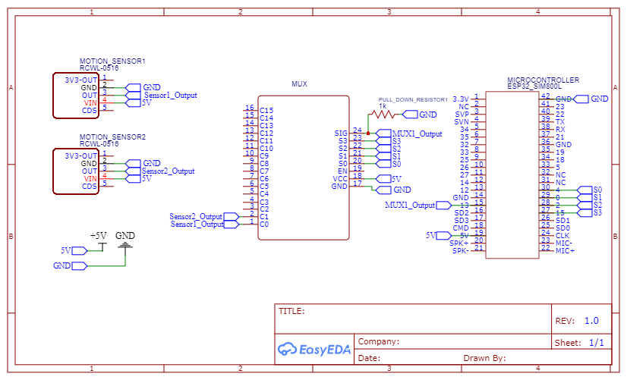
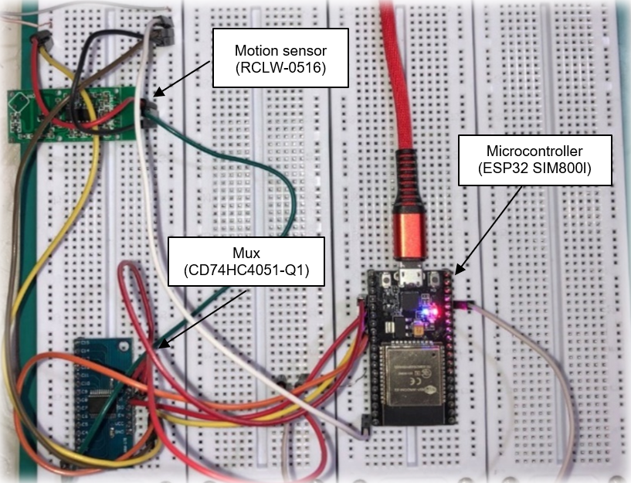
motion monitoring subsystem
Equipment
Breadboard
Connection wires
ESP32 SIM800l microcontroller
1K ohm Resistor
Analog Mux CD774HC4051-EP
Motion sensor RCWL-0516

Slide 40
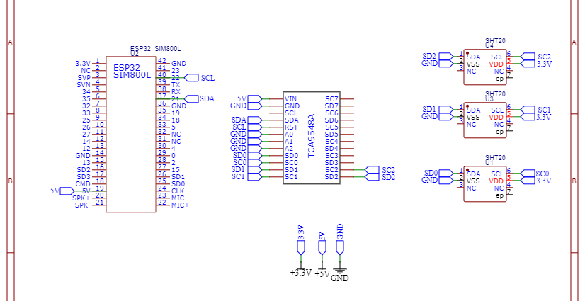
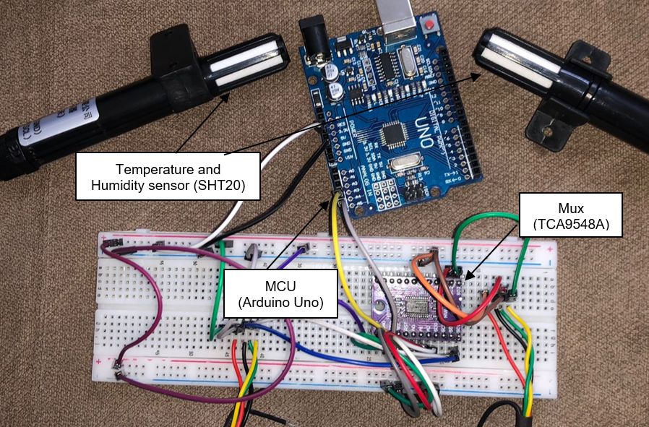
temperature, AND humidity monitoring subsystems
Equipment
Breadboard
Connection wires
Arduino Uno
I2c Mux TCA9548A
Temperature and Humidity sensors (SHT20)

Slide 41
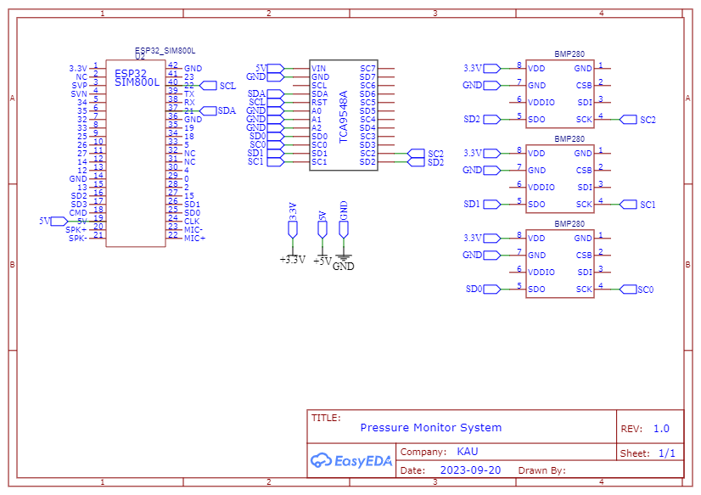
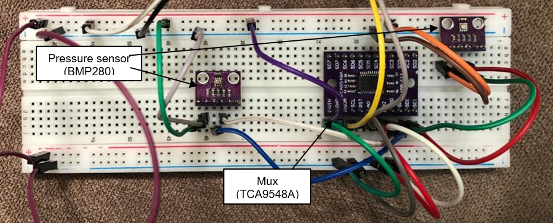
PRESSURE monitoring subsystem
Equipment
Breadboard
Connection wires
Arduino Uno
I2c Mux TCA9548A
Pressure sensors (BMP280)

Slide 42
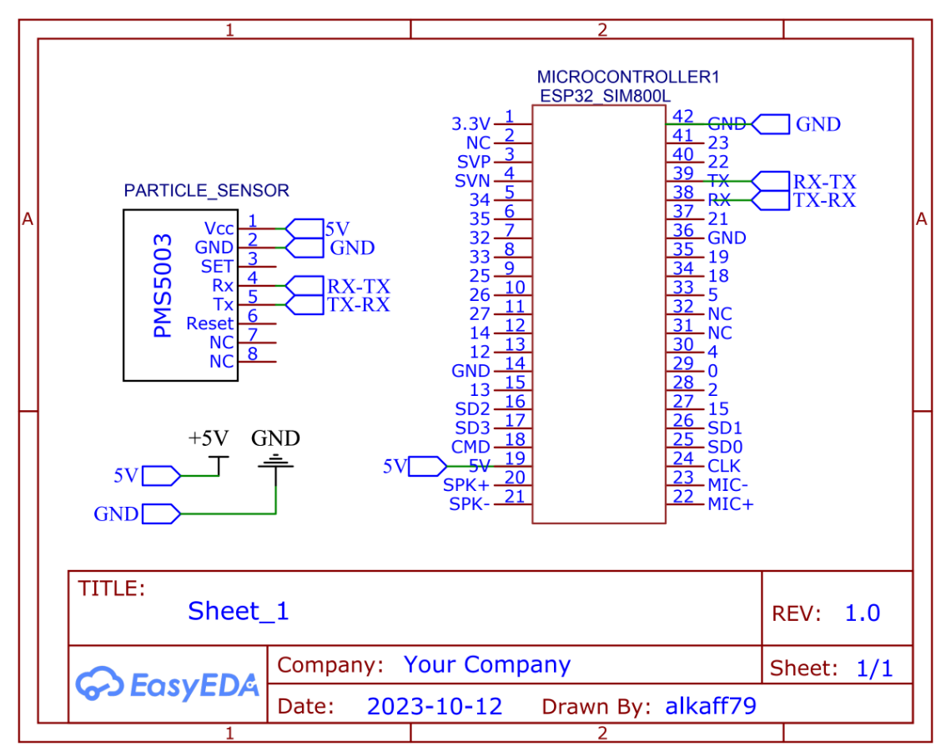
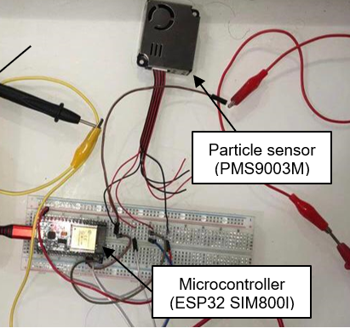
particle detecting subsystem
Equipment
Breadboard
Connection wires
ESP32 SIM800l microcontroller
Particle sensor (PMS9003M)

Slide 43
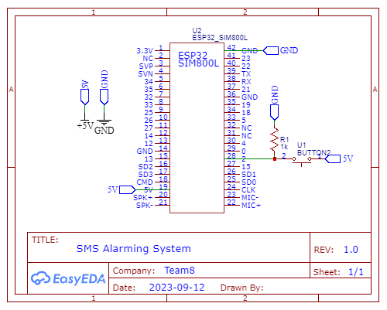
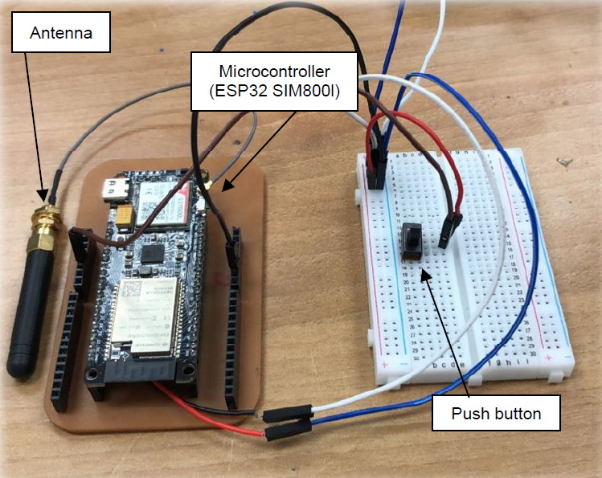
Validating SMs Alarming system
Equipment
Breadboard
Connection wires
ESP32 SIM800l microcontroller
1K ohm Resistor
Switch

Slide 44
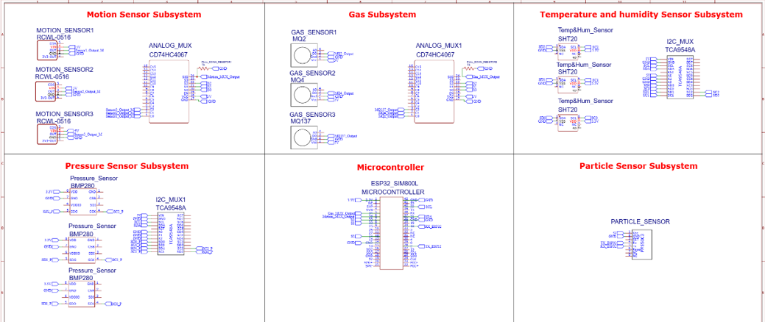
Final Comprehensive system

Slide 45
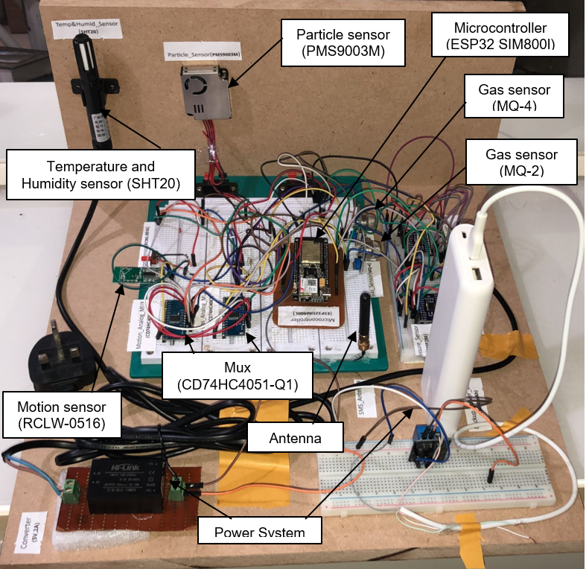
Final product version 1

Slide 46
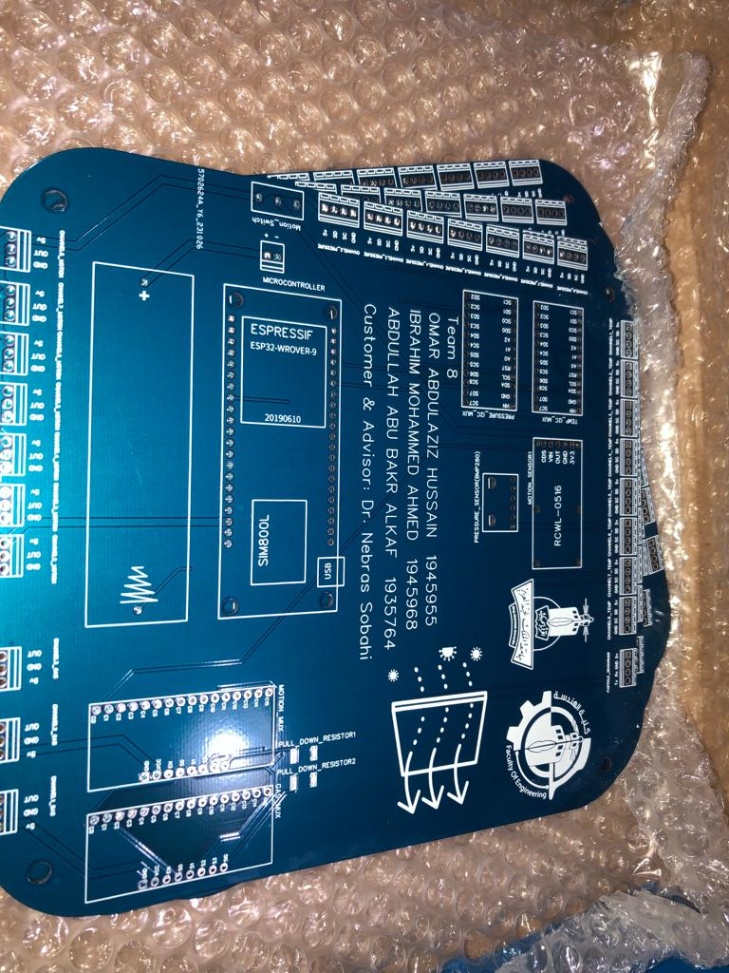
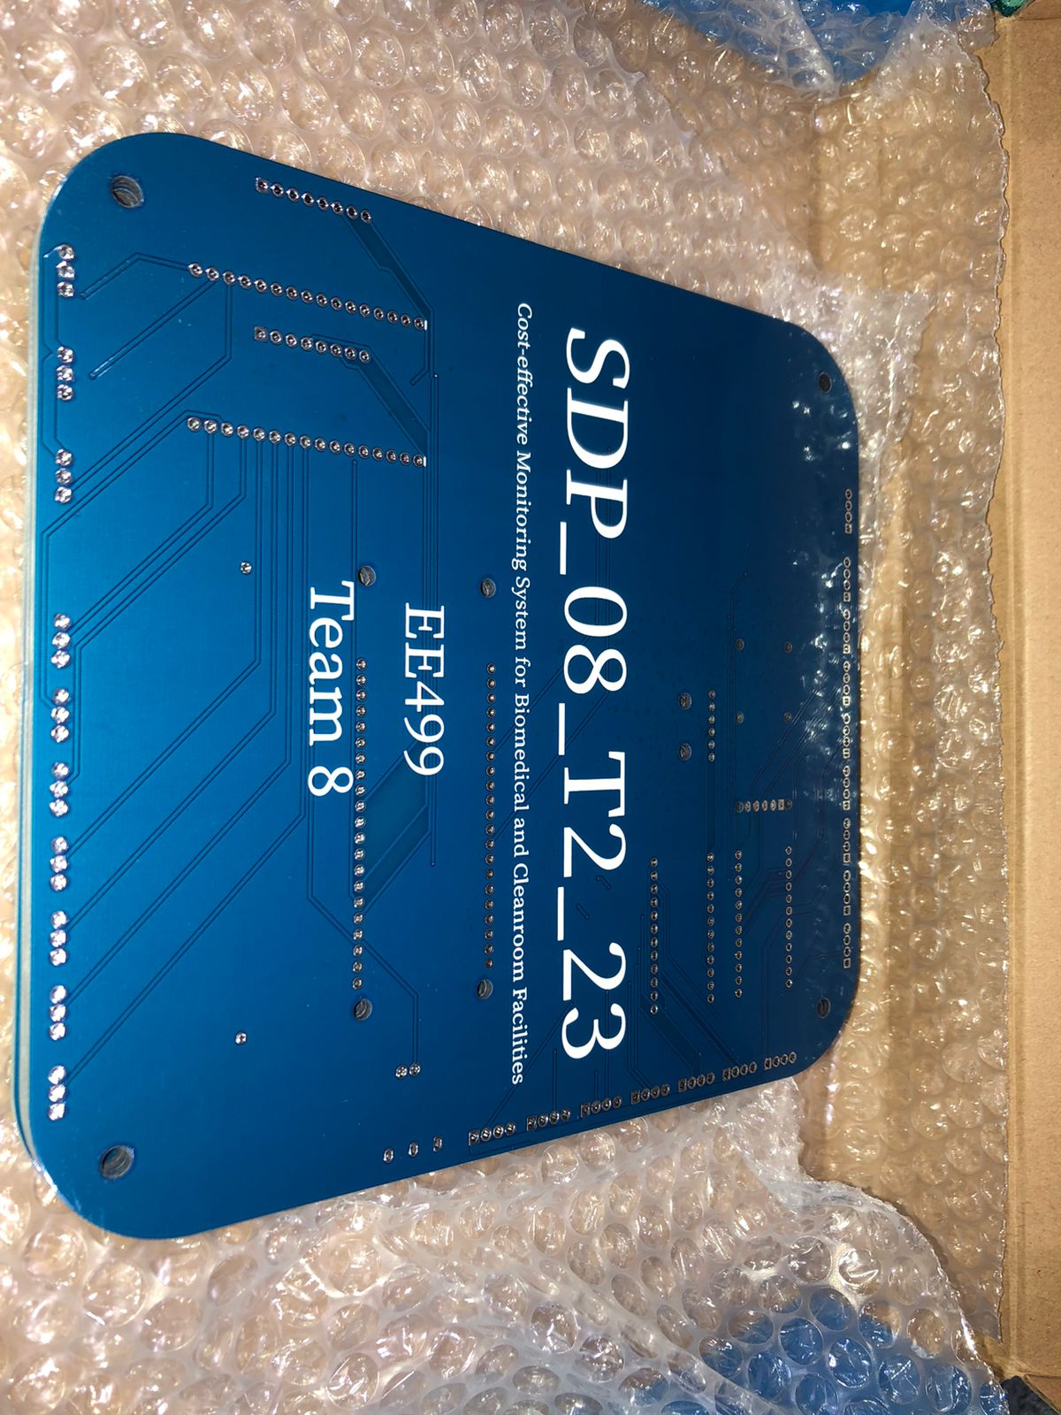
Final product version 2

Slide 47
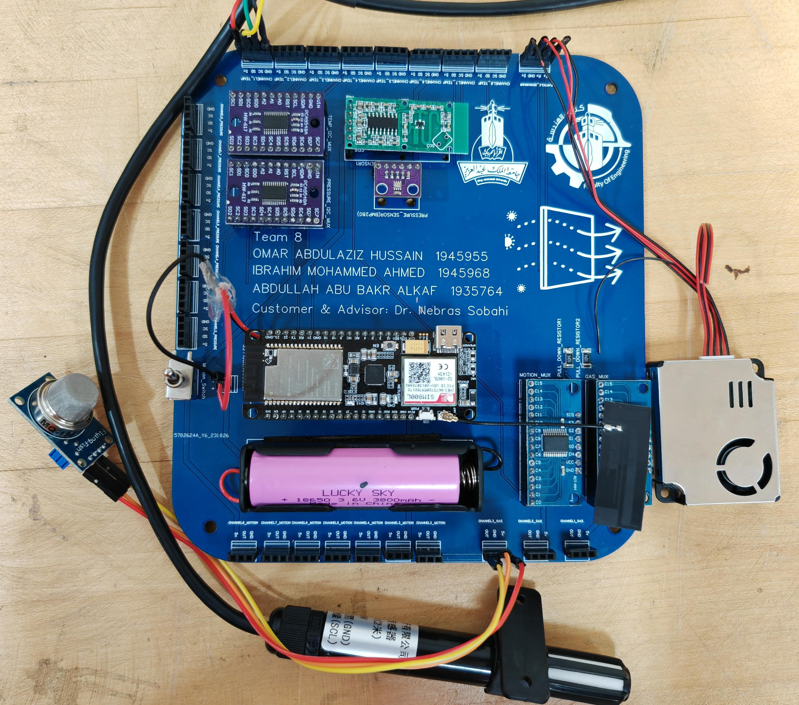
Final product version 2

Slide 48
5. Results and evaluation
Results
Technical Aspects
Impacts of The Design
Financial Aspects
Applicable engineering standards

Slide 49
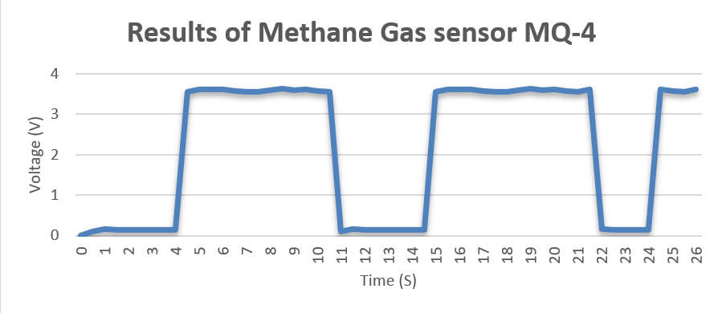
Results of Gases Monitoring Subsystem
Threshold = 2.5 V

Slide 50
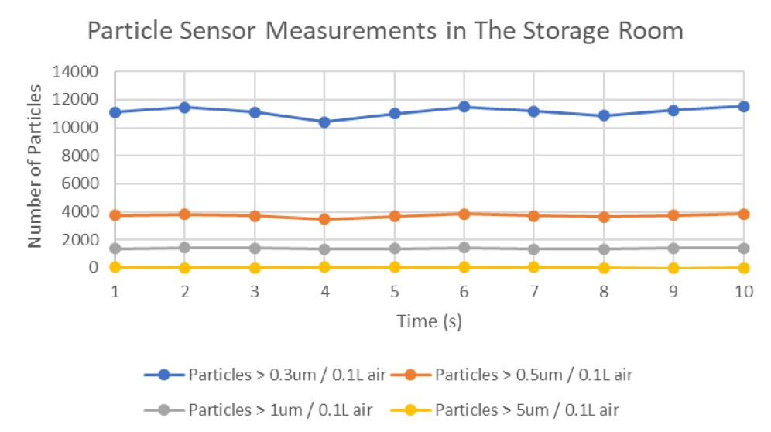
Results of Particle detecting Subsystem
Threshold for P >0.3um=
10,200
Threshold for P >0.5um
= 3,520
Threshold for P >1um
= 832

Slide 51
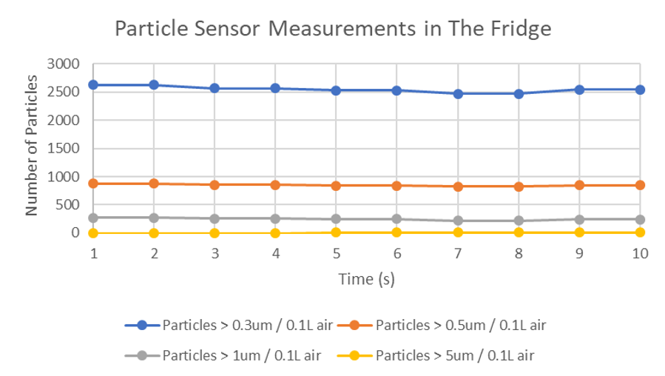
Results of Particle detecting Subsystem

Slide 52
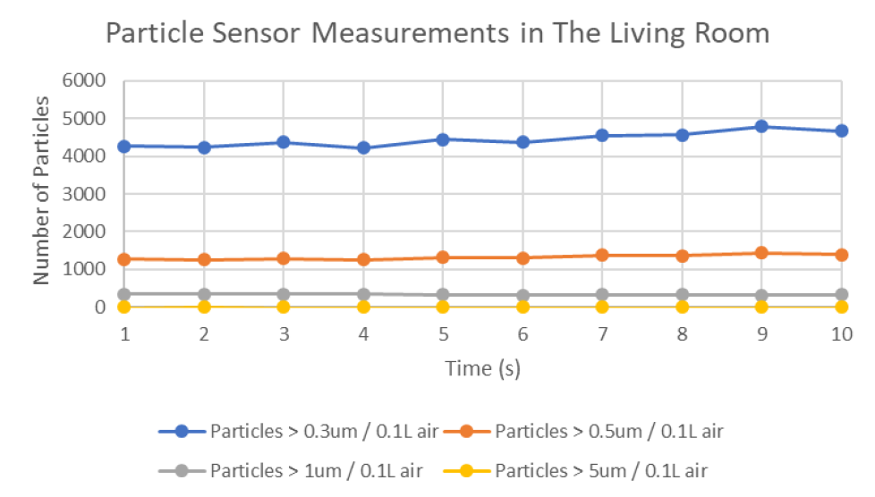
Results of Particle detecting Subsystem

Slide 53
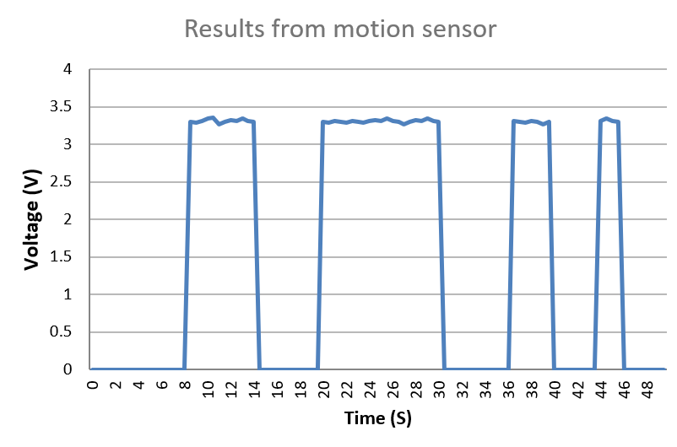
Results of Motion Monitoring Subsystem
Threshold = 2.5 V

Slide 54
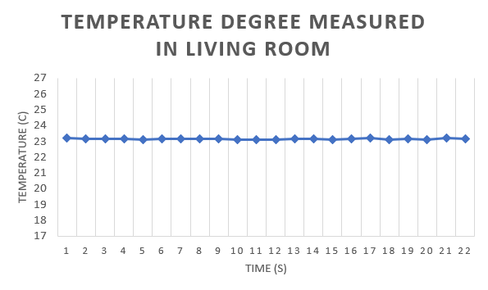
Results of Temperature & Humidity Monitoring Subsystem
Upper limit = 25 C°
Lower limit = 19 C°

Slide 55
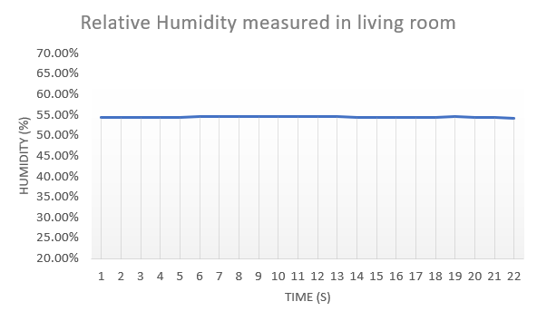
Results of Temperature & Humidity Monitoring Subsystem
Upper limit = 65%
Lower limit = 25%

Slide 56
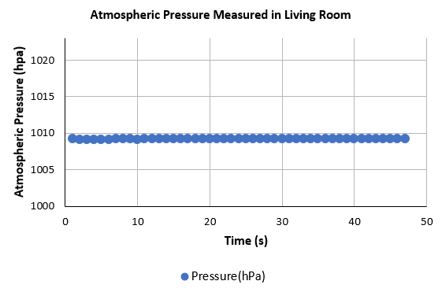
Results of Pressure Monitoring Subsystem
Upper limit = 1023 hPa
Lower limit = 1003 hPa

Slide 57
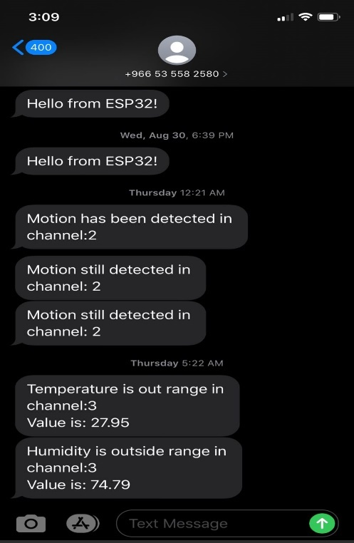
Results of SMs Alarming system

Slide 58
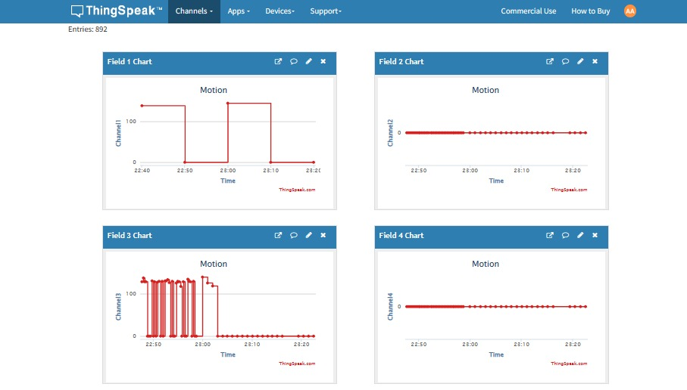
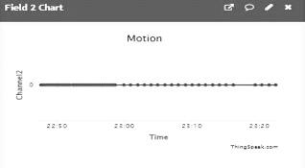
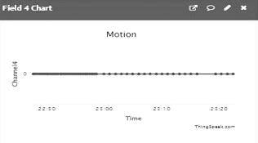
Results of The Final Comprehensive Prototype
Motion Sensor-1
Empty
Channels
Motion Sensor-2

Slide 59
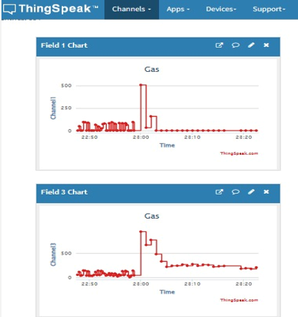
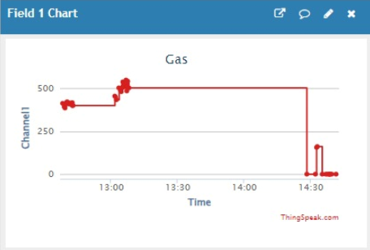
Results of The Final Comprehensive Prototype
Smoke Sensor
Methane Sensor

Slide 60
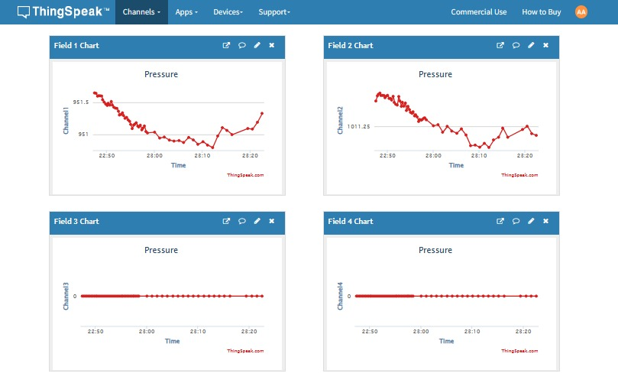
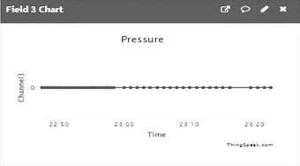
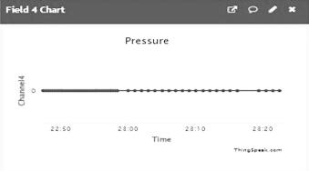
Results of The Final Comprehensive Prototype
Pressure Sensor-1
PressureSensor-2
Empty
Channels

Slide 61




Results of The Final Comprehensive Prototype
Empty
Channel
Empty
Channels
Temp Sensor-1

Slide 62




Results of The Final Comprehensive Prototype
Empty
Channel
Empty
Channels
Hum Sensor-1

Slide 63
Applicable engineering standards
ISO 14644-1 (Particle classification standard)^{[12]}
Saudi Council of Engineers (SCE)^{[13]}
GE-T9 (Magnetism and Electricity)
GE-T12 (Project Management)
GE-T13 (Ethics and Professionalism)
Institute of Electrical and Electronics Engineers (IEEE)^{[14]}
P802.11 (Standard for Information technology)

Slide 64
Technical aspects
Cost-effective system
Suitable for several kinds of cleanrooms
Backup power system
Informing the user about the situation of the cleanroom continuously
The system is generic and able to work with additional subsystem

Slide 65
Financial Aspects
#Number | Component | Quantity | Price (SR)
1 | 220AC – 5DC CONVERTER | 1 | 29
2 | Power Bank | 1 | 99
3 | Relay (5V) | 1 | 25
4 | BMP280 | 2 | 27
5 | SHT20 | 2 | 133
6 | RCLW-0516 | 2 | 15
7 | PMS9003M | 1 | 442
8 | CD74HC4051-EP | 2 | 24
9 | TCA9548A | 2 | 32
10 | ESP32 SIM800l | 1 | 91
11 | MQ-4 | 1 | 24
12 | MQ-2 | 1 | 35
13 | MQ-137 | 1 | 63
14 | SIM Card | 1 | 80
Total (SR) |  |  | 1,350
Project Cost Analysis

Slide 66
Impacts of the design
Environment
Toxic Substances & Battery waste.
Society
Opportunities for small cleanrooms.
Global
Firms can get a cost-effective system.
Safety
Chemical, Electrical, and Radiational risks.
Financial
Effective from the economical side.

Slide 67
6. conclusion
The Challenges
Analyzing all the collected data at the same time.
The speed of the response from the microprocessor.
Solution
Precise monitoring system, that monitor temperature, relative humidity, atmospheric pressure, motion, toxic gases, and particles inside the cleanroom that follows ISO-5 classification.
Impact
Offering reliable and cost-effective monitoring system for small cleanrooms.

Slide 68

Future work recommendations
Adding UART Mux
Develop serial communication for long-distance
Monitoring differential and positive pressure
Improve dual core performance of the ESP32 SIM800l microcontroller

Slide 69

Rules and Responsibilities
M1 – Omar Abdulaziz Hussain
Motion Monitoring Subsystem (Software & Hardware)
Gases Monitoring Subsystem (Software & Hardware)
M2 – Ibrahim Mohammed Ahmed
Temperature & Humidity Monitoring Subsystem (Software & Hardware)
Particle Detecting Subsystem (Software & Hardware)
M3 – Abdullah Abu-Bakr Alkaf
SMS Alarming Subsystem (Software & Hardware)
ThingSpeak cloud data representation
Final Comprehensive Prototype (Software & Hardware)
Pressure Monitoring Subsystem (Software & Hardware)
Reports Responsible
Power Point slides designer
Reports Assistance
Power Points Slides Assistance
PCB Designer
Schematics and Blocks Designer
Team Leader

Slide 70
7. References
[1] M. I. Rosli and M. R. Ahmad, “Internet of things monitoring system of a modeled cleanroom,” ELEKTRIKA. [Online]. Available: https://elektrika.utm.my/index.php/ELEKTRIKA_Journal/article/view/283. [Accessed: 23-Feb-2023].
[2] E. A.- styleshout.com, “Research on the Temperature & Humidity Monitoring System in the Key Areas of the Hospital Based on the Internet of Things,”IJSH. [Online]. Available: https://gvpress.com/journal/IJSH/. [Accessed: 23-Feb-2023].
[3] “Gas and air quality detection, and monitoring using embedded system for ...” [Online]. Available: https://www.researchgate.net/profile/Damian-Valles/publication/327209768_Gas_and_Air_Quality_Detection_and_Monitoring_Using_Embedded_System_for_Nanofabrication_Facility/links/5b802f30a6fdcc5f8b6474a1/Gas-and-Air-Quality-Detection-and-Monitoring-Using-Embedded-System-for-Nanofabrication-Facility.pdf. [Accessed: 23-Feb-2023].
[4] “Clean room technology in art clinics,” Google. [Online]. Available: https://books.google.com.sa/books?hl=ar&lr=&id=ZmsNDgAAQBAJ&oi=fnd&pg=PA19&dq=monitoring%2Bsystem%2Bfor%2Bcleanrooms%2Bbased%2Bon%2Biso%2Bstandards&ots=uUTULW3z6b&sig=uOT9nPdwUkfkHkkjowPk_7HpIXU&redir_esc=y#v=onepage&q=monitoring%20system%20for%20cleanrooms%20based%20on%20iso%20standards&f=false. [Accessed: 23-Feb-2023].
[5] Cleanroom Monitoring System. (n.d.). https://www.laboratory-equipment.com/cleanroom-monitoring-system-sensoscientific.html
[6] USP 800 Hardwall Cleanrooms for Hazardous Drug Compounding. (n.d.). https://www.terrauniversal.com/usp-800-hardwall-clean-room-for-hazardous-drug-compounding.html
[7] Clean Room Monitoring - 3-Room Package. (n.d.). Sonicu. https://shop.sonicu.com/products/clean-room-monitoring-3-room-kit
[8] Clean Room Monitoring System – THP-303 – Libratherm Instruments. (n.d.). https://www.libratherm.com/product/clean-room-monitoring-system-thp-303/
Technologies, B. T. (2019, November 5). Taking a Look at Ideal Cleanroom Temperature and Humidity Standards. Blue Thunder Technologies. https://bluethundertechnologies.com/taking-a-look-at-idea-cleanroom-temperature-and-humidity-standards/ . [Accessed: 10-Sep-2023].
[9] IBM Research - Zurich. (n.d.). Cleanroom technology. https://www.zurich.ibm.com/pdf/nanocenter/Factstheet_Cleanroom_EN_2.pdf [Accessed: 10-Sep-2023].
[10] IBM Research - Zurich. (n.d.). Cleanroom technology. https://www.zurich.ibm.com/pdf/nanocenter/Factstheet_Cleanroom_EN_2.pdf [Accessed: 10-Sep-2023].
[11] Connect 2 Cleanrooms. (n.d.). ISO 14644-1 Class 5 Cleanroom Classification Guidelines. https://shorturl.at/prTW4 [Accessed: 10-Sep-2023].
[12] 1.https://www.researchgate.net/profile/Robert-Terkola/publication/281232293_Clean_room_environment_personnel_quality_assurance_and_their_Monitoring/links/5720766008aeaced788adba3/Clean-room-environment-personnel-quality-assurance-and-their-Monitoring.pdf
[13] H. Scott Fogler, and Steven E. LeBlanc, Strategies for Creative Problem Solving, Prentice Hall Publisher, Printed in U.S.A., 1995.
[14] “IEEE SA - IEEE standard for Telecommunications and information exchange between systems - LAN/man specific requirements - part 11: Wireless Medium Access Control (MAC) and Physical Layer (PHY) specifications: High speed physical layer in the 5 GHz Band,” IEEE Standards Association. [Online]. Available: https://standards.ieee.org/standard/802_11a-1999.html. [Accessed: 23-Feb-2023].
“ISO 14644-1:2015,” ISO, 13-Aug-2021. [Online]. Available: https://www.iso.org/standard/53394.html. [Accessed: 23-Feb-2023].

Slide 71

Thank you!
Feel free to ask Questions

